Slide 1

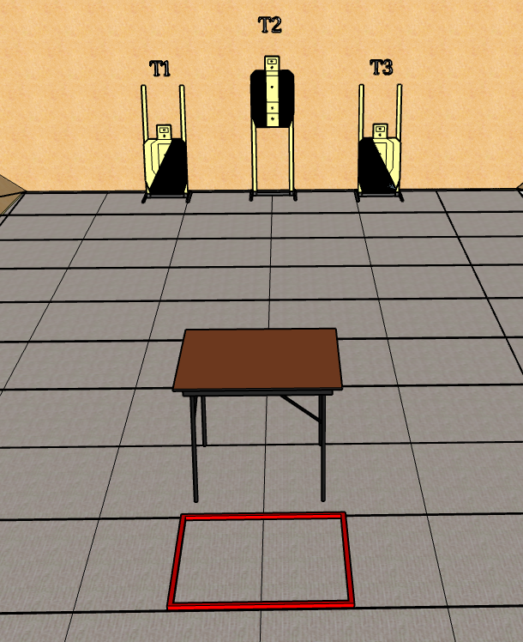
 | Renton Fish and Game Bay 8 Under The Table Course Designer: Eric Beerbaum

Slide 2
Stage 8 Under The Table Course Designer: Eric Beerbaum
Under The Table is a 12 round, 60 point Virginia short course. There are 3 metric targets. The best four hits per target will score. The start signal is audible
The Handgun start position is standing in Box A with wrists below belts. Handgun is loaded and holstered. The PCC start position is standing in Box A. PCC is loaded with stock touching belt.
String 1: On the audible start signal, engage T2 freestyle with two rounds only. Perform a mandatory reload then engage T1 and T3 from under the table with two rounds only and strong hand only. String 2: On the audible start signal, engage T2 freestyle with two rounds only. Perform a mandatory reload then engage T1 and T3 from under the table with two rounds only and weak hand only. Shots not taken from under the table as required will incur a per-shot procedural penalty per 10.2.2 ALT: String 1: On the audible start signal, engage T2 freestyle with two rounds only. Perform a mandatory reload then engage T1 and T3 with two rounds only and strong hand only. Strong hand only shots must pass under the table. String 2: On the audible start signal, engage T2 freestyle with two rounds only. Perform a mandatory reload then engage T1 and T3 with two rounds only and weak hand only. Weak hand only shots must pass under the table. Shots not passing under the table as required will incur a per-shot procedural penalty per 10.2.2

